Slide 1
Addressing Loneliness and Social Isolation Sharing the Experience
Ms. Lorna Kenny
Dr. Siobhan O’Sullivan
Prof Cathal O’Connell

Slide 2
Introduction
Collaboration between UCC and Respond! Housing association
Funded by the Irish Research Council
Healthy ageing in place with a positive ageing ethos
535,393 people aged 65 years and over living in Ireland
2013 20% Respond! residents are older persons. Projected 30% in next ten years

Slide 3
Aims of the research
IRC opportunity to develop skills and knowledge in the area, both for itself and the wider social housing community
Support social housing landlords, voluntary and local authority to identity and develop strategies, supports and interventions to prevent social isolation and loneliness among older people
Contribute to a growing evidence base on supports for older people addressing loneliness and social isolation and guide good practice and future development

Slide 4
Methodology
Literature review
Explorative
Focus Groups

Slide 5
What is social isolation and loneliness?
Social isolation is a state in which an individual lacks a sense of social belonging and engagement with others. A person may have a minimal number of social contacts or an absence of contact with other people and society.
Loneliness is a subjective experience that involves an individual’s emotional response to their social connections. A person can feel lonely due to dissatisfaction with the frequency and closeness of their social contacts or loss of the companionship of an intimate romantic partner, family member or friend.
“Language has created the word ‘loneliness’ to express the pain of being alone. And it has created the word ‘solitude’ to express the glory of being alone”
(Paul Joseph Tillich)

Slide 6
Prevalence
Just under a third of older people (approx. 136,000) live on their own
TILDA- sex, education, health and loneliness across the age spectrum
Golden et. al. (2009) 35% of 1299 people over 65 years in Dublin
Drennan et. Al (2008)-683 people surveyed over age 65 had high romantic loneliness
A 2011 report into loneliness linked some older loneliness to the erosion of local communities and community infrastructure

Slide 7
What’s it like to be lonely?
Feeling lonely is like being thrown in at the deep end with no one to save you.
Loneliness is a killer. It’s a terrible fear for old people like me.
Loneliness eats away at you over time.
Respond! Residents Quotes

Slide 8
Consequences
Significant impacts on both physical and mental health
Increased mortality
Increased risk of dementia
High blood pressure
Depression
Some people say to me: ‘as you get older, you get more invisible’ (Respond! Staff)

Slide 9
Impact
Families, friends and neighbours (loneliness as ‘contagious’)
Communities (e.g contribution of older people in our community)
Broader society (e.g associated with hospital readmission, and early admission to long-term care

Slide 10
Causes
Prevalence of people feeling lonely ‘sometimes’ or ‘often’ is among the highest for those in mature adulthood and old age
The younger generation doesn’t involve the family, they have their own way. Even our own families are like that; my own family you hardly see them, they’re going here and there. They’re so busy.
(Respond! Resident)
I have no brothers or sisters and I miss having close friends but I have lost a lot of friends, you see. Including my own husband.
(Respond! Resident)

Slide 11
Risk Factors
Societal: access to transport, physical environment, participation in community, suitable housing, use of technology, fear of crime, a changing neighbourhood and society.
Personal: poor health, sensory loss, loss of mobility, less income, bereavement, retirement, caring for another person.
I suppose as people get older...where your physical body is not able to be mobile so that creates isolation. And then you have physical barriers like in terms of our streets, our public transport systems, our public buildings. They create barriers for older people.
(Respond! Staff)

Slide 12
Social Involvement
Increased well-being
Reduced cardio-vascular damage
Health enhancing behaviours
Increased self-esteem
I think it’s important to have a social grouping which allows you to express your interests and hobbies. One can get isolated without such things.
(Respond! Resident)

Slide 13
Respond!’s Approach
National Coordinator of Services for Older People
Individual Personal Profiles
Educational, social and recreational programmes
Interagency and partnership approach
Peer Leaders
Community Buildings, Day Centres and Community Gardens
It is about establishing strong partnerships. We as workers do not work in isolation, nor do we provide services in isolation. It’s about collaboration, working together for the betterment of older people’s lives ultimately.
(Respond! Staff)

Slide 14
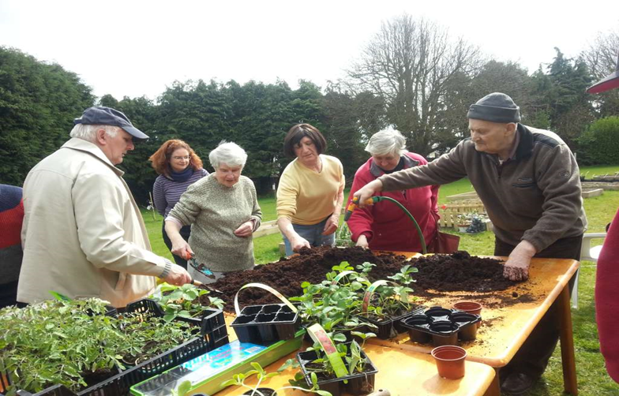
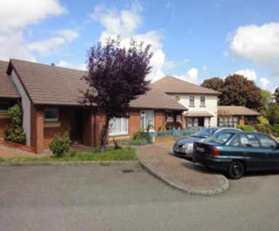
Respond! Initiatives

Slide 15
Benefits of Living in Respond! Housing
Everyone’s on a first name basis here. There’s a great sense of community since I came to live with Respond! And we keep an eye on one another. If anyone has not been present for a while, you’d enquire about them.
With the resident support we sometimes have a chat. We talk about memories and about people you know and years ago when we were young.
Respond! staff are easy to talk to and they understand.

Slide 16
Challenges

Slide 17
Challenges
To identify those who are, or are at risk of becoming, isolated or lonely, build and improve social connections in communities, working across partnerships in order to protect those at risk of loneliness and isolation
To create an environment where people can connect with their neighbours, communities or people of the same interest
Scope of this research

Slide 18
Responding
Older people as diverse as the communities in which they live
Assessing individual needs
Diverse solutions with different inputs
Effective interventions usually involve;
Consultation
Flexible and adaptable
Interagency and partnership approach ‘outward facing’
Make every contact and conversation count
Creating quality relationships (reciprocal relationships)
We have experience in life and we should be listened to. (Respond! Resident)
Looks at the individual needs, instead of putting everyone under the same category.
(Respond! Staff)

Slide 19
Some questions to think about for the rest of the day
How do we make every contact count?
How do we look after the health and wellbeing of our communities, colleagues and ourselves?
How do we resource prevention in difficult times?
How do we ensure community assets are used to their full potential?
How do we give the gift of time?
Let’s see how we can all talk about loneliness and social isolation!

Slide 20
THANK YOU!
Lorna.kenny@ucc.ie
Siobhan.osull@ucc.ie
C.oconnell@ucc.ie

