Slide 1
www.mcauleyplace.ie
Human Rights and Choices
for
OUR Older Age
Margharita Solon
Responding to Isolation and Lonliness
Housing and Community Perspectives
26 November 2015
Notes:
The focus of my presentation is on how to avoid lonliness and isolation for OUR older age. Many of you are here because you want to make a difference to the clients for whom you are the service provider. Please leave that thought behind as you receive this presentation. This is for YOU,,FOR YOUR OLDER AGE…FROM TODAY.

Slide 2
Will I be old? Will you?
Notes:
I did a course in Oncology at the Royal Marsden Hospital in London. At the first lecture the tutor stated: One in three of you will develop cancer. I do not have cancer but I do have a terminal condition. It is called life. You are going to die. Prepare for it. Will you be old? Prepare for it. Will where you are when you are old make you feel older? Will where you are when you are old enable or disable you? Will the mere fact of WHERE you are affect how you are? Will you be connected to your community or isolated and lonely? What rights do older people have and are they considered in government policy for older persons?

Slide 3
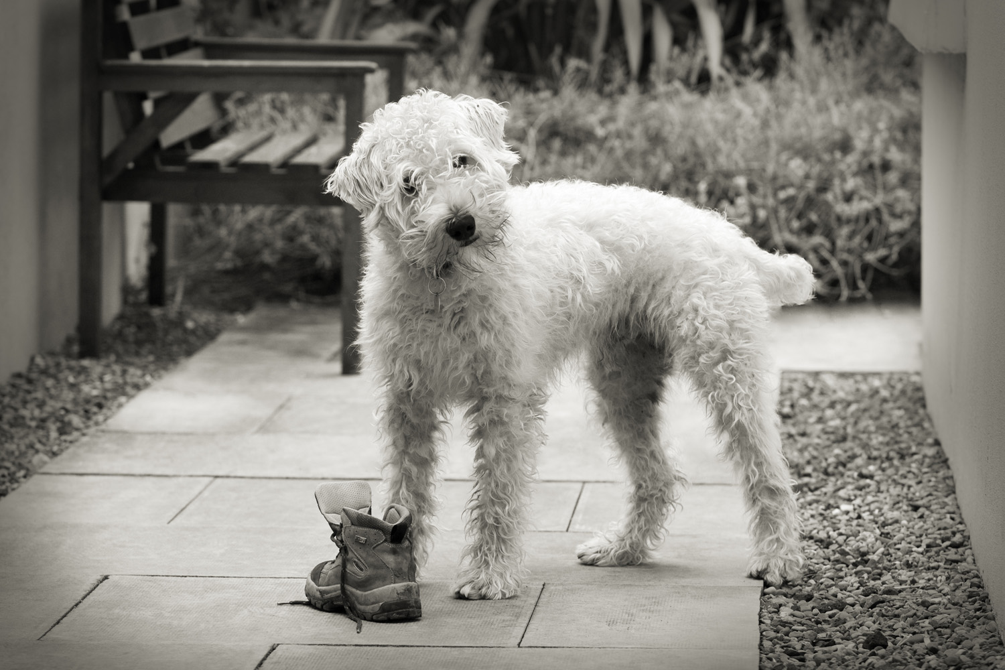
Notes:
Animals have rights..”All dogs require ongoing mental and physical stimulation, as well as HUMAN COMPANIONSHIP, SOCIALIZATION AND TRAINING.
No animal should be left in the back yard, away from family, isolated and deprived of attention. Pets will not thrive. left in alone for long periods of time.. Regular exercise and activity is a must. Socialize your dog early on. By exposing your dog to various people and environments, it will become a more stable, happy, and confident animal. ( From: People for Paws Rescue, Inc. website) We do not accept leaving a dog alone for more than a day. Why do we accept leaving an older person home alone for up to a week with no awareness or acknowledgment of how isolation and lonliness are having a detrimental affect on their wellbeing?I scurrent policy of providing minimal care hours to isolated and lonely older people actually incubating them for costly and unwanted longterm care?” Reducing social exclusion can lead to greater social cohesiveness and better standards of health and reduce premature mortality” (WHO Europe, 2003)
UNITED NATIONS PRINCIPLES FOR OLDER PERSONS:
6. Older persons should be able to reside at home for as long as possible.
Participation 7. Older persons should remain integrated in society, participate actively in the formulation and implementation of policies that directly affect their well-being and share their knowledge and skills with younger generations.
8. Older persons should be able to seek and develop opportunities for service to the community and to serve as volunteers in positions appropriate to their interests and capabilities.
Care Older persons should have access to health care to help them to maintain or regain the optimum level of physical, mental and emotional well-being and to prevent or delay the onset of illness. 16. Older persons should have access to the educational, cultural, spiritual and recreational resources of society.

Slide 4
A dog needs more than food and shelter. It needs human touch, affirmation, expectation of the unexpected, exercise. It is unacceptable to leave a dog home alone for 24 hours.
Why do we accept that Older People are left alone for several days with no human contact? Is this a human rights abuse? Does it incubate older persons for long-term care? We are the next generation of Older Persons. What choices will be available for us?
LINC.IE
Notes:
Core elements of McAuley Place for those who want to replicate the model: Location. Intergenerational. Non medical. Creativity/Cultural entitlement.
Interior design &Expectation of unexpected

Slide 5
Why Loneliness Can Be Deadly
Katharine Gammon, Live Science Contributor March 02, 2012
Loneliness can send a person down a path toward bad health, and even more intense loneliness. Those who are socially isolated suffer from higher all-cause mortality, and higher rates of cancer, infection and heart disease.
Get a Buddy: Closeness May Breed Wellness
Michael Schirber Live Science Contributor October 21, 2004
The key to a quick recovery may be a spoonful of tender loving care -- at least for those who are socially inclined.
In two separate animal studies researchers have found social contact speeds healing rates.
A Choice: Age in the Right Place
In the heart of your community, avoiding lonliness and enhancing wellness.

Slide 6
Room with a View
Notes:
How many older persons are living alone with little or no human contact week after week. In a house without a view? How many Older persons are inappropriately placed in congregated care settings because they have no other viable choices? Government policy is to develop more Residential beds for YOU and ME as older persons in the future. Are these actually congregated care settings? The cost of one of these residential beds for one week is an average of €1,000. And the Health service has no spare resources. What do you want to have available for your older age? Note policy for people with a disability in Ireland:The HSE and all relevant stake holders are fully committed to supporting the transition of each individual identified as currently living in a congregated type setting to a more socially inclusive community integrated service over the next number of years the real world…with the possibility of making new stories? Government policy for people with a disability is not to build any more “congregated settings”. But government policy for older persons is to provide more residential beds….How long will it take to realise that this is not what we want?

Slide 7
Notes:
We want to live independently at the heart of a vibrant community..in an anti fragile environment, with the expectation of the unexpected, where age is irrelevant. We are uncomfortable about being grouped by age as we are older. If I asked anyone with a disability to stand up, how would you feel? Years ago we isolated people with physical disabilities like cerebral palsy or downes syndrome into segrated institutions. Now we realise how wrong that was and they are supported to live independently and integrated in their own communities. Years ago extended families lived together and grandparents looked after grandchildren, supported by the middle generation. Now we have creches, after school clubs, gaf cafes, youth clubs, care of the aged centres, and many older people in appropriately in longterm residential care settings. How can we join the dots and reconnect communities?.Does anyone know how much it costs to keep an older person in a nursing home for a week? Our taxes are used for this purpose. Government policy for Older People now affects us financially and will affecct us physically, socilally, psycholigically and spiritually when WE are the older people

Slide 8
Expectation of the unexpected!
Notes:
Baz inserting his 71-year-old mother Nancy into various dare-devil situations, and filming her typical Irish mammy reactions to the situations

Slide 9
Volunteer Hub
‘Sine qua non’
Notes:
Volunteer hub with original Volunteer Coordinator, Volunteers and international visitors.
McAuley Place could not be all that it is without the incredible support of the wonderful volunteers that work there.
All volunteers are inducted and training is provided.
There is a volunteer programme also for local transition year students.

Slide 10
Location, Location, Location
Notes:
Central location..walking distance..even with a walking frame, to shops, post office, hairdresser, bank, bus stop.

Slide 11
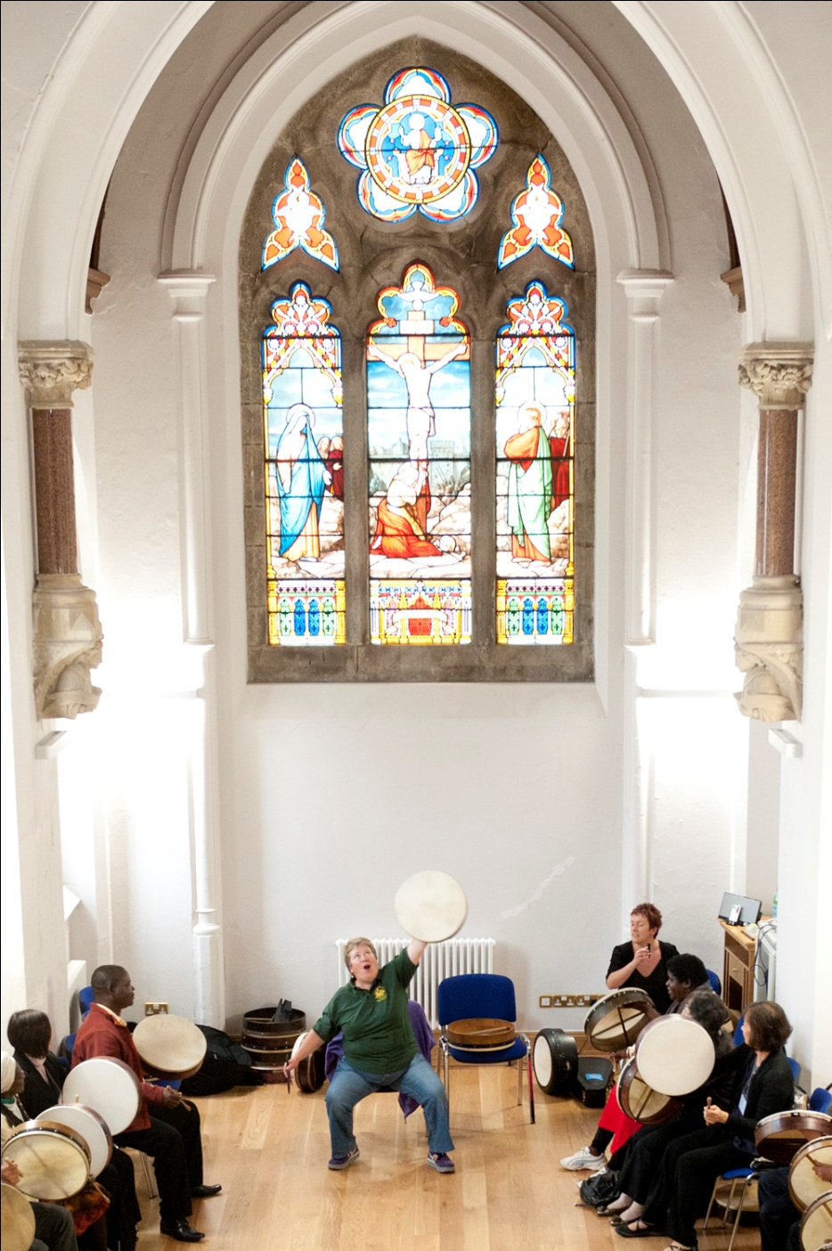
Our Arts and Culture Centre
Notes:
The Arts and Culture Centre is attached to the Housing development.
It hosts numerous events and is a venue for wedding ceremonies.

Slide 12
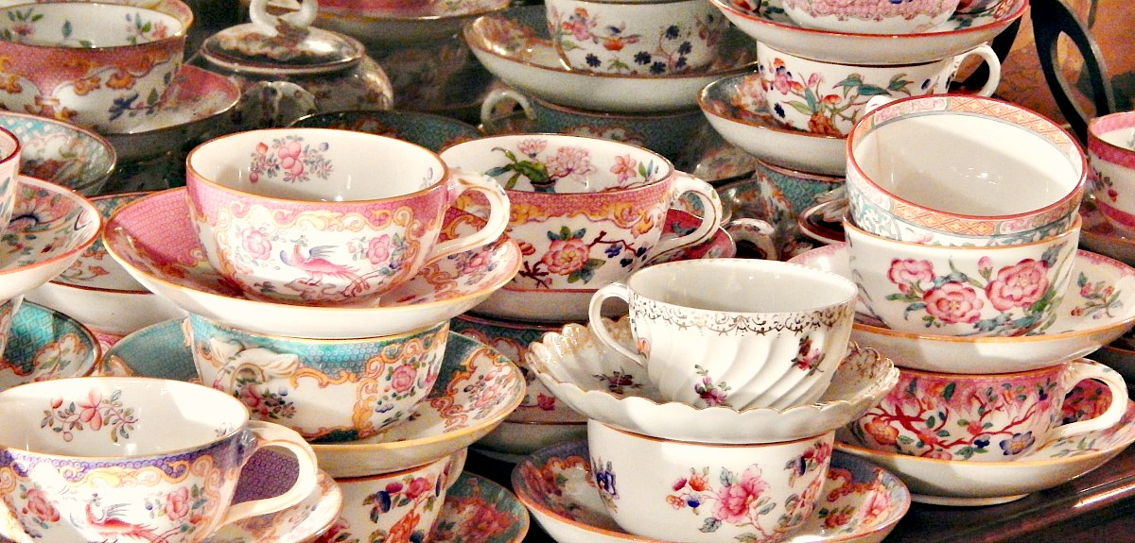
The Convent Tea Rooms
Notes:
The Convent Tea Rooms is open to the entire community.
It is staffed by a manager, people on community employment schemes and dedicated volunteers.
Baking is done in house and the smell of the baking creates a very welcoming atmosphere.
Tea leaf tea is served in a tea pot with a tea cosy knotted by McAuley Place crafts group.
China tea cups help to create the very special feel of the Convent Tea Rooms.

Slide 13
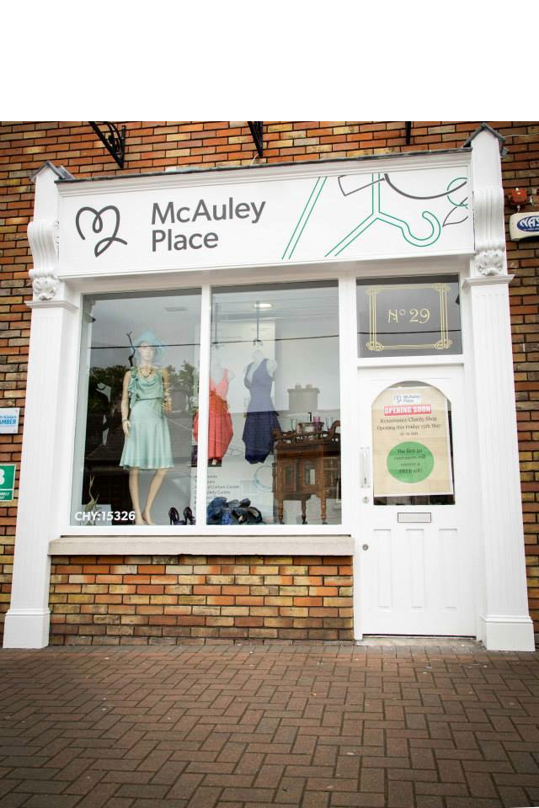
Hidden Treasures
Notes:
Volunteer hub with original Volunteer Coordinator, Volunteers and international visitors.
McAuley Place could not be all that it is without the incredible support of the wonderful volunteers that work there.
All volunteers are inducted and training is provided.
There is a volunteer programme also for local transition year students.

Slide 14
Proposed Health through Learning Centre
Notes:
The Health through Learning Centre will be a STEP UP facility at McAuley Place.
It will consist of a community lounge, three creative spaces and accommodation for an artist in residence.
It will lead out to an urban woodland garden.
It will be a’ drop in’ as well as a ‘hang out’ space for all ages in the community.

Slide 15
Creativity Creates Connections
Notes:
Year long intergenerational community arts project. Received European funding. International seminar on the project. Can have many more similar projects when Health through Learning Centre is developed .Money spent on the arts as tolls for engagement can have many more benefits than costly and inappropriate medication. I was with a lady in her 90th year in hospital. Two days before she died, when she could hardly swallow sips of water, she was given calcium tablets by the nurse. This was to prevent osteoporosis. Are we subjected to mindless treatments at the cost of our wellbeing? Is health funding inappropriately being spent?.

Slide 16
Presidential Endorsement
Notes:
President Michael D Higgins in the Arts and Culture Centre recommending McAuley Place as a national exemplar.

Slide 17
What They Say
Volunteer:
I knew practically nobody in Naas before I started to volunteer in McAuley Place. Now I meet lots of people I know on the street and have made many new friends.
Before I became a volunteer I used to hear the word "community", I didn't know what it really meant. Through all of this my world has become bigger and better.
Tenants:
I pinch myself every morning I wake up here to make sure I am not dreaming I live in this wonderful place..
I have halved my pain medication since I moved in here.
My brother would not be alive today if he had not moved in here.

Slide 18
“A great fire burns within me, but no one stops to warm themselves at it, and passers-by only see a wisp of smoke”
― Vincent van Gogh
When you have nobody you can make a cup of tea for, when nobody needs you, that's when I think life is over.”
― Audrey Hepburn

Slide 19
Intergenerational Solidarity
Notes:
Intergenerational solidarity and nurturing growth and learning and transfer of skills at McAuley Place

Slide 20
Our Future is in Our Hands
Ar scáth a chéile a mhaireann na daoine
It is in the shelter of each other that people live
Notes:
"If the fires of freedom and civil liberties burn low in other lands, they must be made brighter in our own." ~ President Franklin D. Roosevelt, in a 1938 address to the National Education Association

