Slide 1


Studying & Tackling
Loneliness in Deprived Areas
Ade Kearns
26th November 2015
Glasgow Community Health and Wellbeing
Research and Learning Programme:
Investigating the Processes and Impacts of Neighbourhood Change

Slide 2
Structure of the Talk
What is loneliness?
Who is affected?
The impacts of loneliness.
------------------------------------------------------------
Studying loneliness in Glasgow – GoWell.
Prevalence and mental health associations.
Social networks and loneliness.
Environmental influences on loneliness.
Implications of the findings.

Slide 3
Loneliness

Slide 4
What is Loneliness?
Solitude:
  Choosing to spend time alone. Associated with self-discovery, connecting with one’s feelings, and creativity.
Isolation:
  Not having other people in your immediate surroundings.
Loneliness:
  “A distressed emotional response to the difference between the social relationships you desire and those you experience.” (Age Scotland)
  The feeling of being on one’s own, associated withi not having sufficient intimate and/or other contacts, or contacts of the right type.” (Kearns et al 2014)
  A vicious circle: lonely people lose confidence and withdraw more from social engagment.

Slide 5
Societal Trends Towards Loneliness
Geographical mobility.
Reliance on technology for transactions and interactions.
Individualisation.
Decline in trust, safety and reliance in others.
Lost art of conversation.
Family breakdown.
Lack of mainstream funding for community organisations.

Slide 6


Who is Lonely?

Slide 7
Who is Lonely?
Older people: loss of function; loss of spouse.
Disabled people and their families: accessibility.
Carers: demands of caring; change in income.
Students: change in environment; difficulties making friends.
Young people who are bullied.
Internet users: self-isolation; can facebook make you depressed?
Migrants: the effects of dislocation.

Slide 8
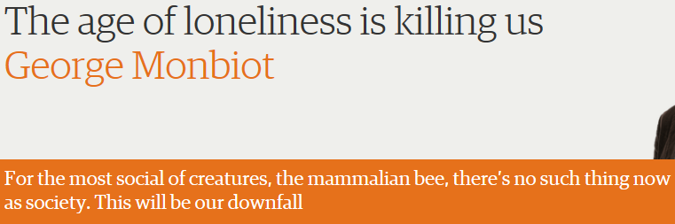

Slide 9
The Impacts of Loneliness
Mortality:
  A meta review of 148 worldwide studies found that the odds of survival were 50% greater for those with strong social relationships.
  A US study of men in their 50s found that chronic loneliness increased the chances of premature death by 14%.
  The effect size has been compared to that of quitting smoking!

Slide 10
The Impacts of Loneliness
Cardiovascular Health:
  Loneliness affects the cardiovascular and immune systems.
  Lonely people sleep less well, and awake regularly.
  Loneliness is a stressor. This leads to sustained higher levels of the stress hormone cortisol, particularly in the morning. This raises the risk of heart attacks and strokes.

Slide 11
The Impacts of Loneliness
Health Behaviours:
  Lonely people drink more alcohol, have unhealthier diets, and take less exercise than others.
  Self-regulation is harder and people become weaker-willed on their own.
  Could also be a response to stress.
  A study using data from Australia from 2003 found that lonely people were more likely to be smokers and more likely to be overweight-obese (Lauder et al 2006).

Slide 12
GoWell: Studying Deprived Populations

Slide 13
GoWell: research objectives
To investigate how regeneration and housing investment affect people, e.g. individual and household health and wellbeing.
To assess the degree to which places and communities are transformed by policy interventions.
To understand the processes that deliver change and support cohesive, sustainable communities.
Notes:
13
The programme has a number of overarching research objectives which are to…………read above.
So we’re evaluating change at 3 levels: Indiv/household; Neighbourhood/community and City
And also from perspective of: the People involved; the Places involved; and the Processes taking place
Overtime the types of Qs we hope to answer are:
Is neighbourhood transformation associated with more cohesive communities?
Can environmental improvement turn around the health outcomes in individuals and communities?
Do people who participate more in their community exhibit better mental health and wellbeing?
What are the psychosocial benefits of neighbourhood change, and how do they relate to specific health outcomes?
.. And many others.

Slide 14
The Interventions
Neighbourhood transformation: Demolition &/or renewal in regeneration areas.
Relocation: from regeneration areas to elsewhere.
Dwelling type change: high-rise to low-rise; existing to improved or new dwellings.
Housing improvements: external fabric; security; central heating; kitchens & bathrooms. (+community level)
Tenure mixing: through redevelopment and in-fill.
Social regeneration: interventions on human, economic, & social capital within communities.
Tenant and community empowerment: housing; regeneration; public services.

Slide 15
Outcomes (interim and final)
Residential Outcomes: housing & neighbourhood satisfaction; psychosocial benefits of home & neighbourhood; area reputation.
Social & Community Outcomes: sense of community; cohesion; social networks and social support.
Health & Human Capital Outcomes: physical health; health behaviours; mental wellbeing – including loneliness; training & skills.
Empowerment Outcomes: individual (housing; household aspirations; employment objectives); collective (planning/regeneration; services).

Slide 16
Pathways to Outcomes
Environmental Pathways, e.g. risk reduction; opportunity enhancement; aesthetic quality.
Social Pathways, e.g. cohesion, trust, reliance; social interaction and support.
Psychosocial Pathways: safety; control; status; sense of progress; reputation; relative deprivation.

Slide 17
Three Investigations
Evaluating the impacts of housing and regeneration interventions.
Identifying the wider determinants of health in deprived communities.
Measuring the effects of public policy upon inequalities across the city.

Slide 18
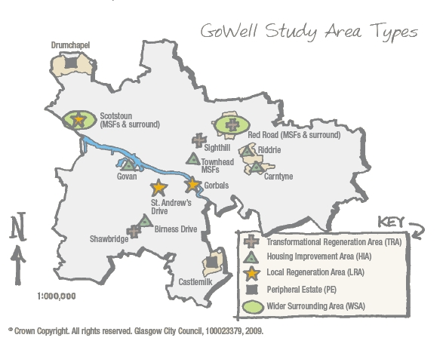
GoWell Study Area Types
Notes:
18

Slide 19
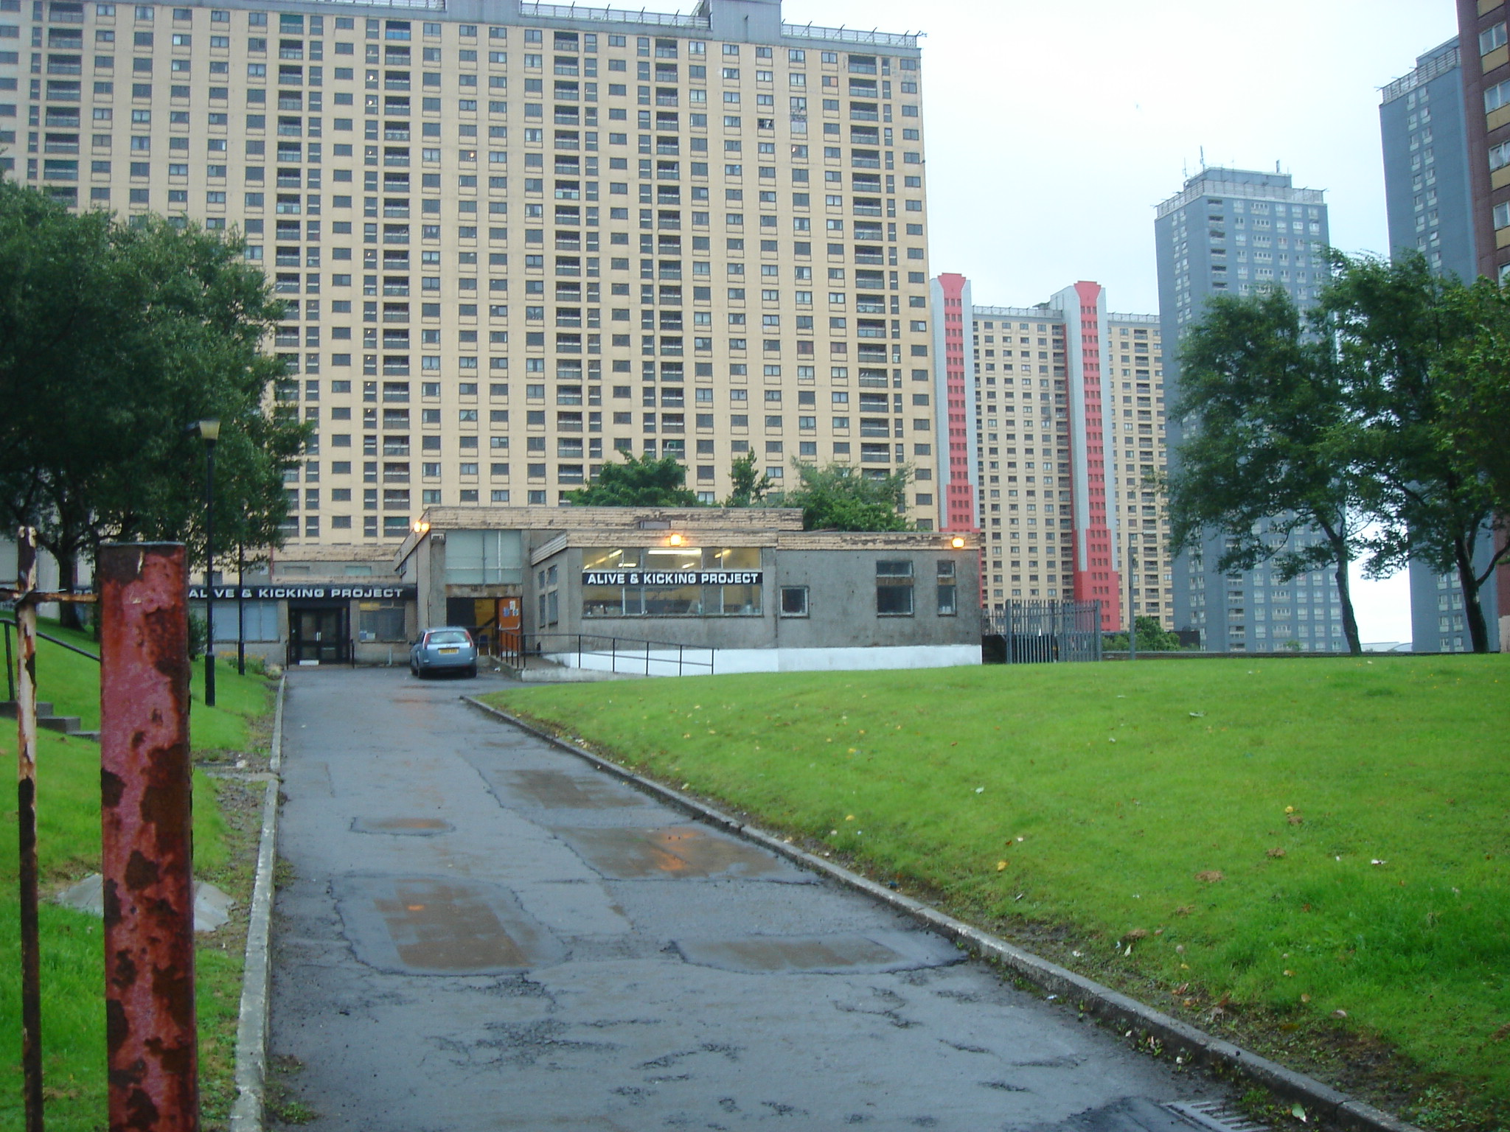
Red Road
Notes:
Red Rd flats (31-storey) built 1960s, North of Glasgow; population 3670 (2761 adults) in 2006. 2 slab and 6 point, built from steel and asbestos, were the tallest in Europe when they were built. Now only 70-80 secure tenancies and majority of population are asylum seekers, refugees and homeless people in temporary lets. These are all due for demolition.
Look imposing.

Slide 20
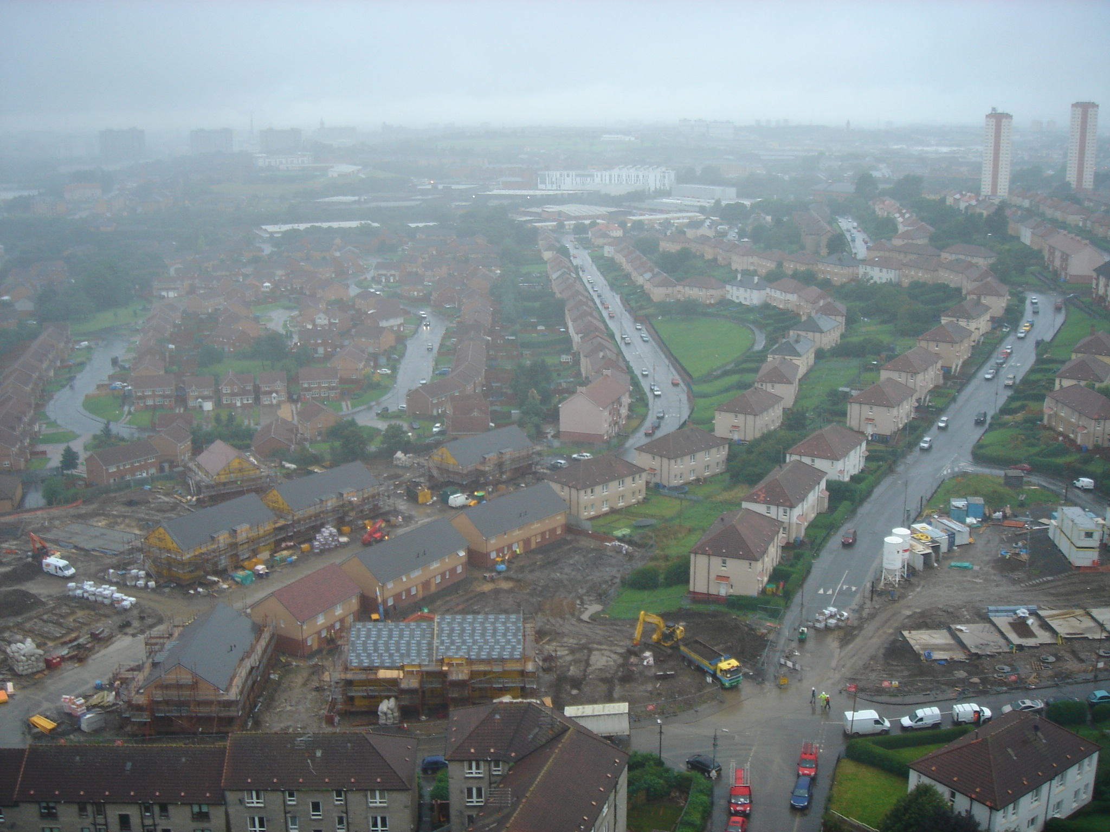
Red Road: Wider Surrounding Area

Slide 21
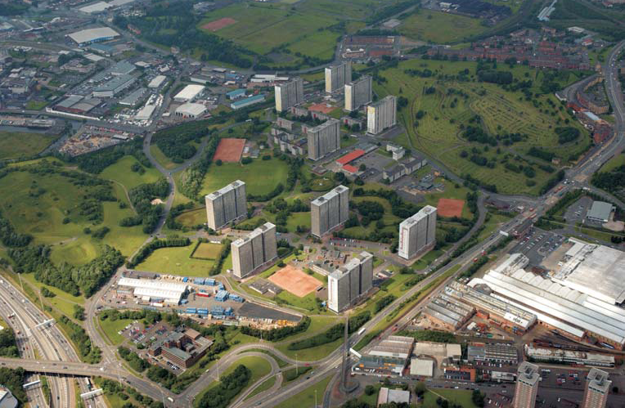
Sighthill
Notes:
Built late 1960s in the North of Glasgow, population 6143 (4488 adults) in 2006. built on former chemical works so much contaminated land.
Close to city centre, motorway etc. Island factor and isolation etc.
in 2001 publicity due to the murder of a Kurdish asylum seeker from Turkey which led to stories of racial tensions and community relations. Area associated with violence, and racially motivated crime. I’m not so sure that’s the case now. Stories in Evening Times about housing and regeneration, GHA, campaigns to retain the high rise flats.

Slide 22
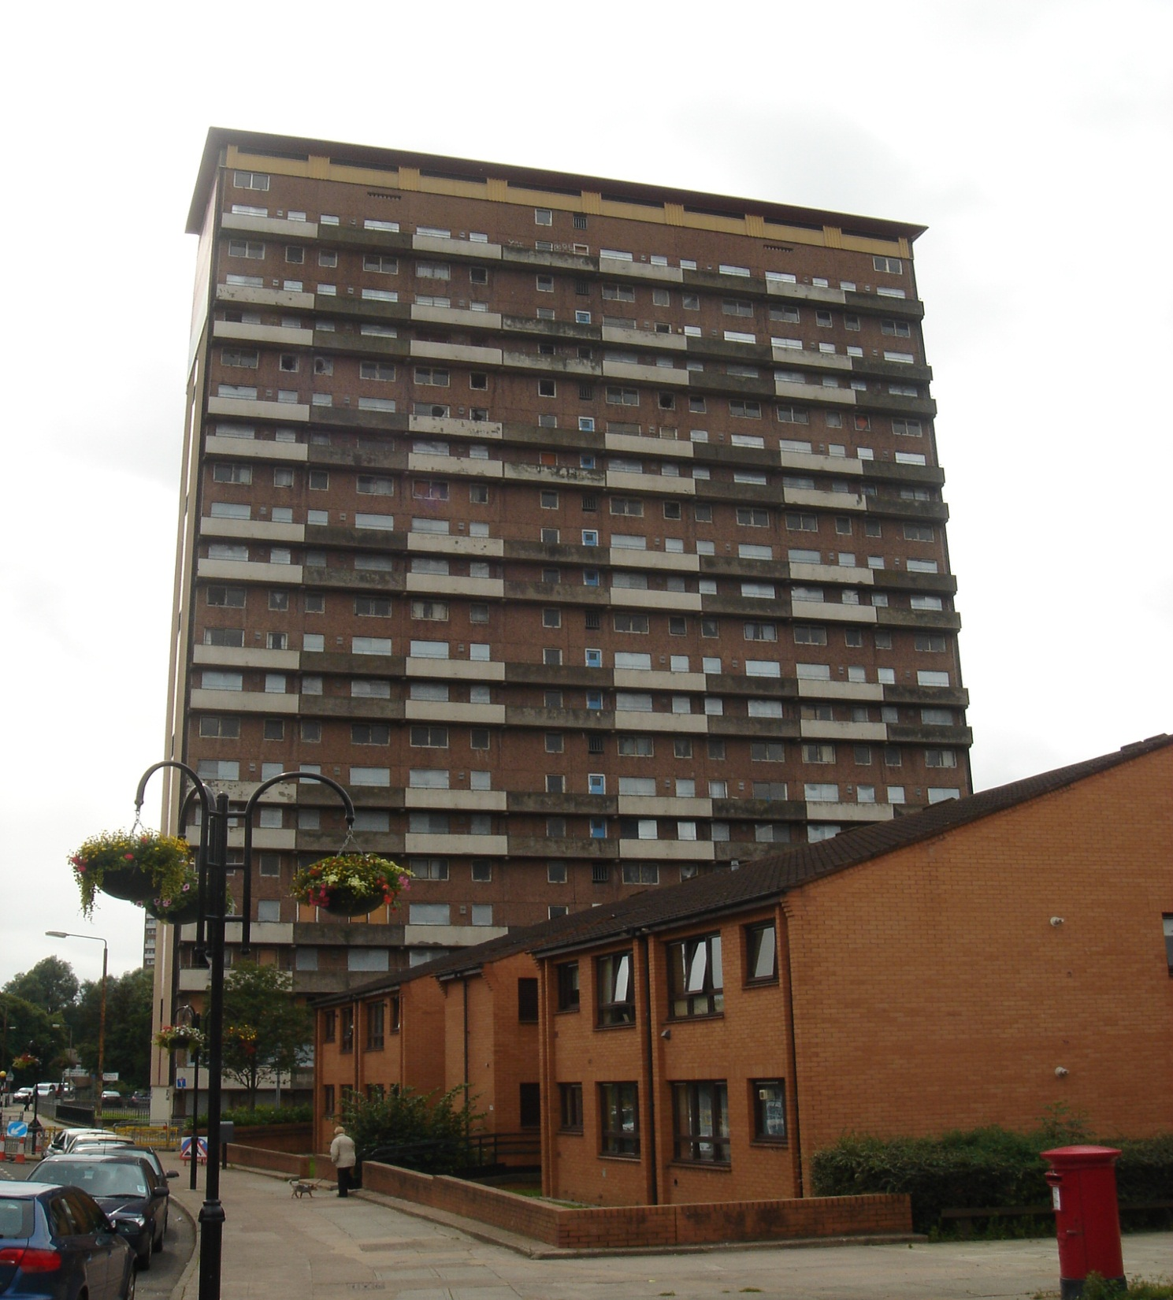
Shawbridge
Notes:
Shawbridge – South of Glasgow adjacent to Pollock Park, high rise flats built 1967; population 2423 (1698 adults) in 2006. Large ASR pop.
Not many people know of Shawbridge compared to the other areas (student from Shawlands didn’t know it existed).

Slide 23
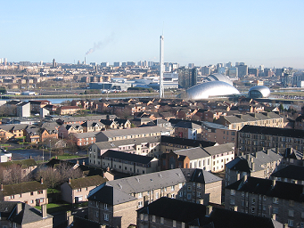
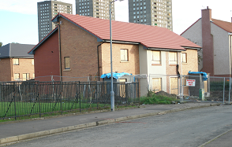
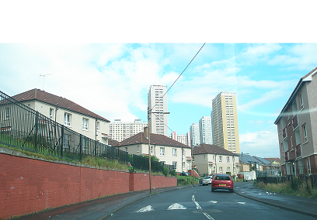
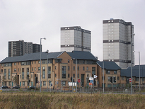
Other area types
Govan (HIA)
Drumchapel (PE)
Red Road (WSA)
Gorbals Riverside (LRA)

Slide 24
Context: Deprivation, 2005

Slide 25
Survival to 65, by area type

Slide 26
Timescale
May 2006
May 2008
May 2011
2015/6
6,016
4,657
4,063
1st survey
2nd survey
3rd survey
4th survey
Longitudinal cohorts (remainers and outmovers)
Focus groups
Addition of East End study
Nested studies:
janitors; youth; play areas
Study of clearance processes
Lived realities
Empowerment and participation research
Mixed tenure
studies
Data linkage: education, crime, health
Ecological monitoring of policy
context and city-wide changes
Economic evaluation
Notes:
26

Slide 27
The Loneliness Question (Wave 3, 2011)
Respondents were asked to choose and option that described their experience in the last two weeks:
  “I’ve been feeling lonely”…
Response Category: | Analytical Category:
All of the time | Frequent Loneliness
Often
Some of the time | Occasional Loneliness
Rarely | No Loneliness
Never

Slide 28
Prevalence and Health Consequences

Slide 29
Loneliness Prevalence
Occasional loneliness: 22% men; 25% women.
Frequent loneliness: 17% men; 15% women.
  Aged 40-64: 18%.
  Older single adults: 19%
  Single adults below retirement age: 25%
  Long-term sick: 32%
  Sample: 4,202.

Slide 30
Loneliness and Mental Health
Those with low mental health (SF-12) were 6x more likely to report frequent loneliness.
Those with worsening stress, anxiety or depression (lasting 12 months or more) were 5x more likely to report frequent loneliness.
Those with low mental wellbeing (WEMWBS) were 3x more likely to report frequent loneliness.

Slide 31
Social Networks and Loneliness

Slide 32
Social Contacts
Not counting the people you live with, how often do you do any of the following:
  Meet up with relatives.
  Meet up with friends.
  Speak to neighbours.
  Most days; once a week or more; one or twice a month; less often than once a month; never.
To what extent does the following apply to you:
  I stop and talk to people in my neighbourhood.
  A great deal; a fair amount; not very much; not at all.
Would you say that you know…in your neighbourhood:
  Most people; many; some; very few; no-one.

Slide 33
Social Contact and Loneliness
Comparison: ‘most days’.
Comparison: ‘a great deal’.
Adjusting for: gender; age; household type; employment; education; long-standing illness; migrant status.
Adjusting for all other social contacts.
Not significant: how many people known in the neighbourhood.

Slide 34
Social Support
How many people could you ask for the following kinds of help, not counting those you live with:
  To go to the shops for you if you are unwell (practical)
  To lend you money to see you through the next few days (financial)
  To give you advice and support in a crisis (emotional)
  None; one or two; more than two; would not ask; don’t’ know.

Slide 35
Social Support and Loneliness
Comparison: ‘more than two people’.
Adjusting for: gender; age; household type; employment; education; long-standing illness; migrant status.
Adjusting for all other forms of social support.
Not significant: financial support.

Slide 36
Environmental Influences on Loneliness

Slide 37
Neighbourhood Environment
‘How would you rate the quality of your neighbourhood in terms of the following:’
  Attractive buildings;
  Attractive environment;
  Quiet and peaceful environment;
  Parks and open spaces;
  Street lighting;
  Paths and pavements.
Very good; good; neither good nor bad; fairly poor; very poor.

Slide 38
Use of Neighbourhood
‘On how many days in the last week, did you walk in your neighbourhood for at least 20 minutes at a time?’ (0 to 7)
‘Do you take part in any social clubs, associations, church groups or similar?’ (yes/no)
In the last seven days, which of these amenities did you use within and outside your local area?’:
  Eleven items listed, e.g. gym; post office; grocers; park.

Slide 39
Neighbourhood and Loneliness
Comparisons: all six items rated as ‘good’; use three or more local amenities.
Adjusting for: gender; age; household type; employment; education; long-standing illness; migrant status.
Adjusting for all other social neighbourhood factors.
Not significant: days walked around the neighbourhood; participation in clubs; use of non-local amenities.

Slide 40
Social Environment
Belonging: ‘To what extent do you feel part of the community?’
Safety: ‘Do you think each of the following is a problem in your local neighbourhood?’ (10 items)
‘How safe would you feel walking alone in this neighbourhood after dark?’
Trust: ‘Is it likely that someone would intervene if a group of youths were harassing someone in the local area?’

Slide 41
Social Environment and Loneliness
Comparisons: feel part of the community ‘a great deal’; know most/many people; no anti-social behaviour identified; agree that neighbours would intervene; feel safe walking at night.
Adjusting for: gender; age; household type; employment; education; long-standing illness; migrant status.
Adjusting for all other social environment factors.

Slide 42
Implications of the Findings

Slide 43
Supporting Individuals
Loneliness is common but the sufferers are hidden.
People in deprived areas experience a lot of Stressful Life Events that they struggle to cope with, and which can trigger or exacerbate loneliness.
There is a need to identify lonely, socially excluded individuals, including those often living alone, with long-term illnesses and mental health problems.
They can be vulnerable, lacking in confidence, and fearful of social stigma.
This is a task for: social landlords; other community members; public/social services.
Better inter-sectoral partnerships are required

Slide 44
Neighbourhood Quality
A poor quality environment may affect someone’s mood and/or support lower levels of social activity. Both can feed into feelings of loneliness.
Good quality neighbourhood design, attractive materials, plus ongoing maintenance are key.
Neighbourhood management is also important to help people feel safe and less concerned or threatened by uncertainties around anti-social behaviour.

Slide 45
Social Regeneration
All three elements of social capital – networks, norms and trust – help prevent loneliness.
Both close networks of support and broader networks of acquaintance are important for social interaction, familiarity and trust.
The means to provide and sustain social amenities within all communities need to be found.
A rich mix of informal social groups and more formalised community organisations is needed to provide social opportunities and ensure everyone has connections.
Social regeneration should be an integral part of any area-based initiative to tackle disadvantage.

Slide 46

Briefing Paper 22: Loneliness in Glasgow's deprived communities
http://www.gowellonline.com/publications
GoWell is a collaborative partnership between the Glasgow Centre for Population Health, the University of Glasgow and the MRC Social and Public Health Sciences Unit, sponsored by Glasgow Housing Association, the Scottish Government, NHS Health Scotland and NHS Greater Glasgow & Clyde.

