Slide 2
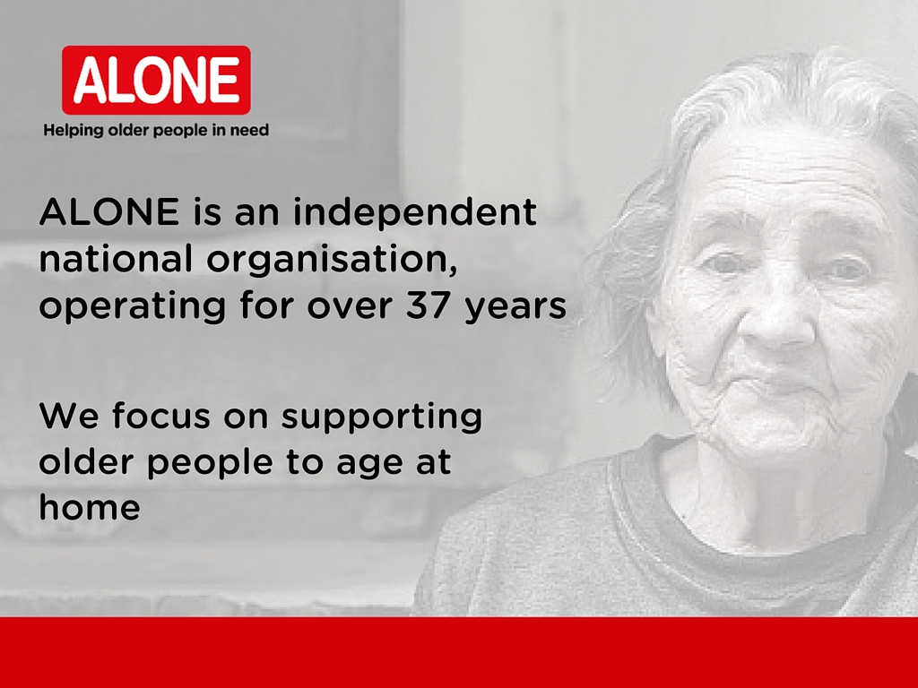
Notes:
Makes sense to individual, community and economy

Slide 3
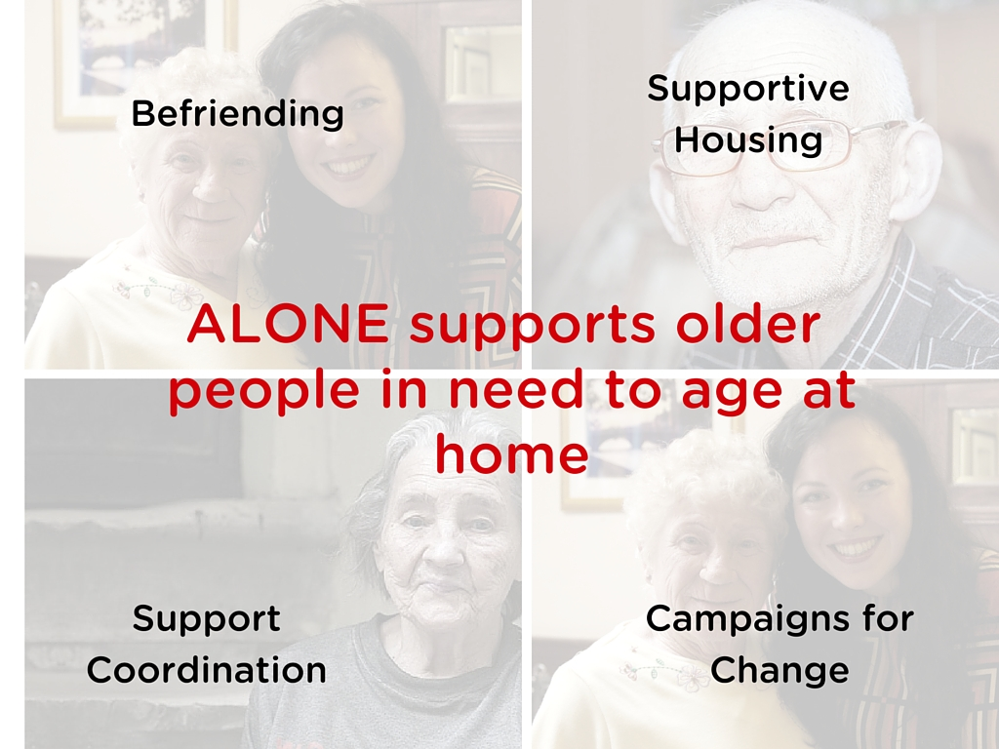
Notes:
All of our services focus on enabling people to age at home

Slide 4

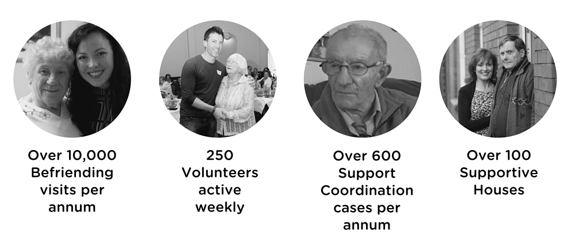
ALONE in Numbers
Notes:
Engaged volunteers, active every week, acting as watches in community – if a problem/older person’s support needs change, professional staff there to support

Slide 5

ALONE – How we work
Older person at the centre
Effective & compassionate
Creative & innovative
Leader in services for older people
Rights based
Solution focussed
Partnerships
Evidenced based
Quality approved
Notes:
Everything we do has the older person at the centre
Don’t duplicate services
Monitoring trends that are emerging in our work and look for creative solutions
All our campaigns are come from the experience of the older people we work with
5

Slide 6

Why is Befriending a Health Intervention?
‘Since ALONE made contact with me my confidence is coming back. There is some purpose in the week.’
Leo, 71
Notes:
We see and hear from the older people we work with the tangible difference Befriending makes to their lives.
Mood increases, gives them more confidence, giver them something to live for

Slide 7
Loneliness is a serious health issue
Loneliness
  Affects physical health
  Increases risk of Alzheimer’s and Dementia
  Causes depression and stress
Loneliness was the biggest issues for older people living alone
Notes:
Loneliness increases GP visits & risk of emergency hospitalisations
Loneliness affects the physical health of older people, affecting recovery from stroke and the frequency of emergency hospitalisations as well as causing depression and stress.
CARDI: Loneliness and physical health, (2012), http://www.cardi.ie/userfiles/May%20Loneliness.pdf
Lonely people are estimated to be twice as likely to develop Alzheimer’s as those who are not lonely.
Loneliness and risk of Alzheimer disease. Wilson RS, Krueger KR, Arnold SE, Schneider JA, Kelly JF, Barnes LL, et al. Arch Gen Psychiatry (2007); 64, pp.234-240
Those who suffer from loneliness have a 64% greater risk of developing clinical dementia.
), Holwerda et al.Feelings of loneliness, but not social isolation, predict dementia onset: results from the Amsterdam Study of the Elderly (AMSTEL), 2012.
Loneliness affects the physical health of older people, affecting recovery from stroke and the frequency of emergency hospitalisations as well as causing depression and stress.
CARDI: Loneliness and physical health, (2012), http://www.cardi.ie/userfiles/May%20Loneliness.pdf
7

Slide 8
Befriending works
ALONE 2015 Befriending Service Evaluation
86% of older people visited no longer report feeling lonely
Age Friendly Ireland study on volunteer visiting:
Primary outcome loneliness decreased in the intervention group at one month and three month follow up
Notes:
We have know it for a long time, but our evaluation was important to quantify the impact of Befriending as a health intervention

Slide 9
ALONE Befriending Service – 37 years experience
10,000 annual visits
250 volunteers trained and vetted
Data management and tracking
Quality standards and systems
2015 external evaluation
Notes:
We know befriending is an important health intervention and as such it needs to be properly managed and monitored
We are in the final stages of achieving/applying for an internationally recognised standard that no other service has in Ireland..
9

Slide 10
Befriending Service – Quality Tracking
Notes:
Salesforce used to track trends so that we can plan and adapt to emerging needs

Slide 11
Befriending Service Nationally
Issue
Calls from older people across the country looking for a service in their area
Response
In 2014 ALONE researched and mapped needs of the sector
Published the 1st National Survey & Directory of Befriending Services in Ireland
Held 1st National Networking Meeting of Befriending Services to explore support up at National Network
Notes:
Over the years we received many calls – knew there was a need - knew we had to respond
11

Slide 12
ALONE National Befriending Survey Conclusions
Gaps in Services
Increase in dementia
Unsustainability
Demand for Training, Support and Networking
Notes:
1.Gaps in Services
Limited services available outside major cities and geographic isolation of rural Ireland could lead to further isolation of older people in our communities, putting their health at serious risk.
2. Increase in Dementia in the elderly
Services supporting older people are seeing increasing numbers of older people coming to them with dementia and Alzheimer’s.
3. Unsustainability
Without funding, training and proper resources many Befriending Services were struggling to survive.
4. Demand for Training, Support and Networking
Demand for training, networking and other supports for Befriending Services.

Slide 13

Befriending Network Ireland
Established in 2015
Hosted by ALONE
40 members
National Advisory Group
Coordinator and 2 year action plan
Notes:
60,000 visits per annum (40 orgs with 30 members visiting 50 weeks a year)

Slide 14
Support for Quality Befriending
Befriending Service Coordination Guidebook
Volunteer training locally and regionally
National Coordinator training
Committed to establishing evidence based, national quality standards for Befriending in Ireland

Slide 15
Risks and hard questions for sector
What difference are we making?
Volunteering doesn’t mean anything goes
Legal responsibilities re safety and protection of older people and volunteers
Hard data collection on evidence of impact of Befriending
Notes:
Need for evidence e.g. scales to prove impact on loneliness
Link quality, impact, evidence and funding

Slide 16
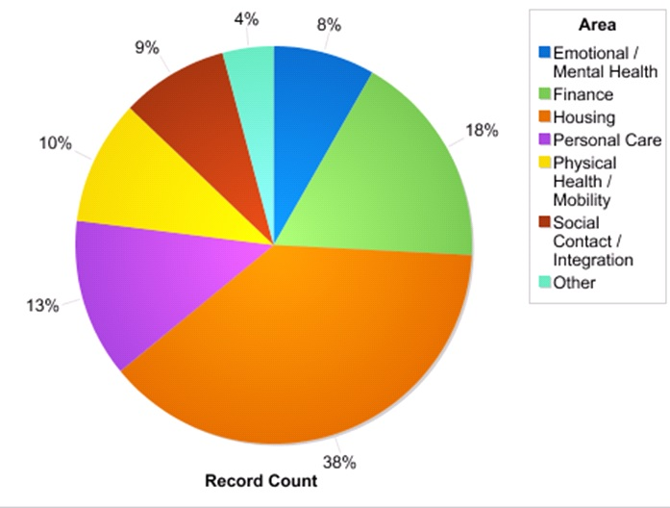
Befriend Technology for quality & evidence
Notes:
Technology – Apps
Collecting national data for impact of all befriending services

Slide 17
Befriending Service &
Support Coordination
Older people have a range of changing needs practical, social, physical & mental health needs
Sooner or later all befriending leads to advocacy and Support Coordination!
Notes:
17

Slide 18
ALONE’s Support Coordination
Older Person &
ALONE Support Coordinator
HSE Primary Care GPs & PHN
Mental Health Service
Social Workers
HSE Home Help &
Home Care Packages
Financial institutions
Other Housing bodies
Family / friends
Hospital,
Geriatrician
Local Authority re housing adaption & grants
DSP re entitlements
Befriending groups
Notes:
Often these agencies have digital interface! Not age-friendly

Slide 19
Support Coordination
Why Support Coordination
Plan, support and track outcomes
Quality standard and protocols
Supported by professional staff
Essential to supporting older people age at home
Challenges and Opportunities
Only done by NGO’s
No agreed name
No national model or standard
No national infrastructure
Notes:
19

Slide 20
Planning for future infrastructure
Regional Support Coordination
Centres
Befriending
Groups
Social & Sheltered Housing
Hospital/ Nursing Homes
Statutory Agencies
Extra Care Housing
Local Advocacy services

Slide 21
Demographic Challenge Ahead
Notes:
65 + age group will almost treble in next 30 years
Just over half a million 65 + population in 2015 - Projected to rise to 1.4 million by 2045
65+ will increase from 11% of population now to 22% of population by 2045
Our population is ageing at an alarming rate and we need to act now to put in place a sustainable infrastructure for our ageing population. Quality, national, coordinated, integrated.
We have an ageing society – that is not going to change and ignoring it is only going to make things worse.
It’s up to us to put sustainable solutions forward and to ensure the

Slide 22
‘No problem can be solved
from inside
the same thinking that created it’
Albert Einstein
‘No learning without action, no action without learning’

Slide 23




Keep in touch!
_{www.alone.ie}
_{ALONE-Ireland}
_{ALONE_Ireland}
_{ALONE Ireland}

